Slide 1
NE 591: Advanced Reactor Materials
Fall 2021
Dr. Benjamin Beeler

Slide 2
Particle fuels

Slide 3
Macrostructure Changes
The macrostructure of the fuel changes with operation
The high temperature will lead to sintering and restructuring into different zones (as in MOX fuel)
Similar four zone restructuring will occur, but with different zones
1: central void; 2: highly dense fuel similar to a pellet; 3: sintered microstructure with retained porosity; 4: original particle macrostructure
As the structure of the fuel changes, the properties change dramatically with radius and time

Slide 4
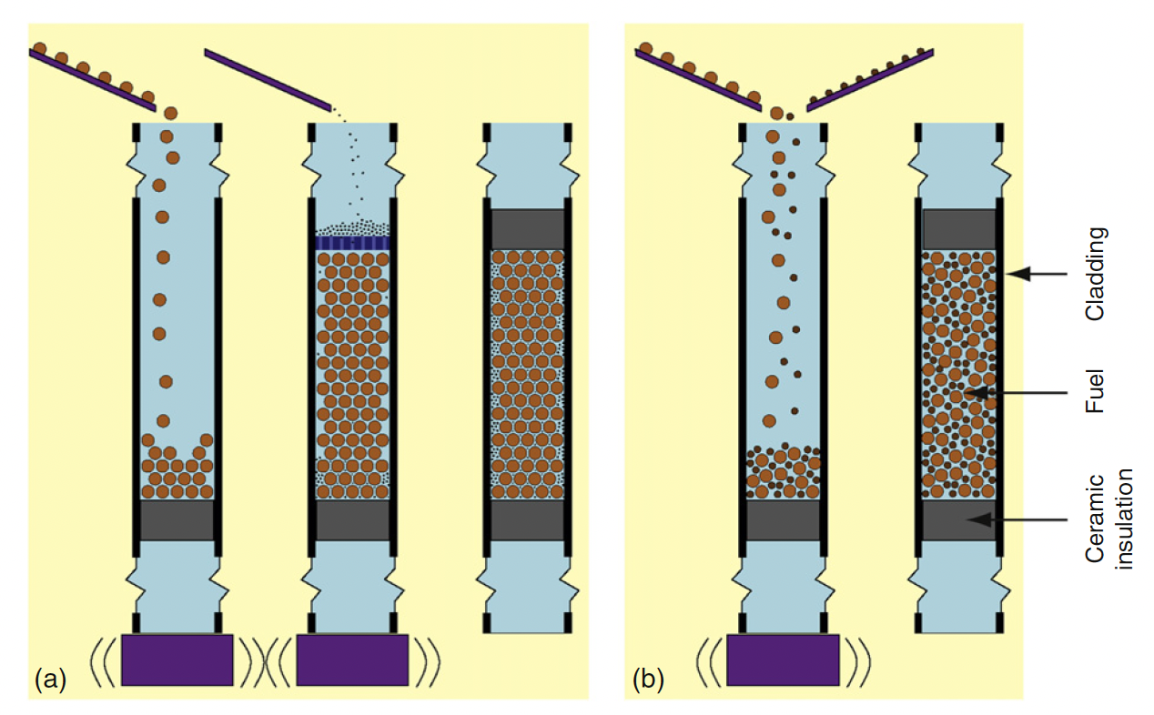
Sphere-Pac Concepts
While the sphere-pac concept is more complex than vipac, it offers additional flexibility
Particle sizes and particle distributions can be included
Spherical particles offer low friction resistance during the filling procedure
Sphere-pac can thus reach up to 90% smear density
Infiltration filling (image a) allows for tailoring of small particles to serve specific purposes, such as an oxygen getter, a low reactivity with cladding, etc.

Slide 5
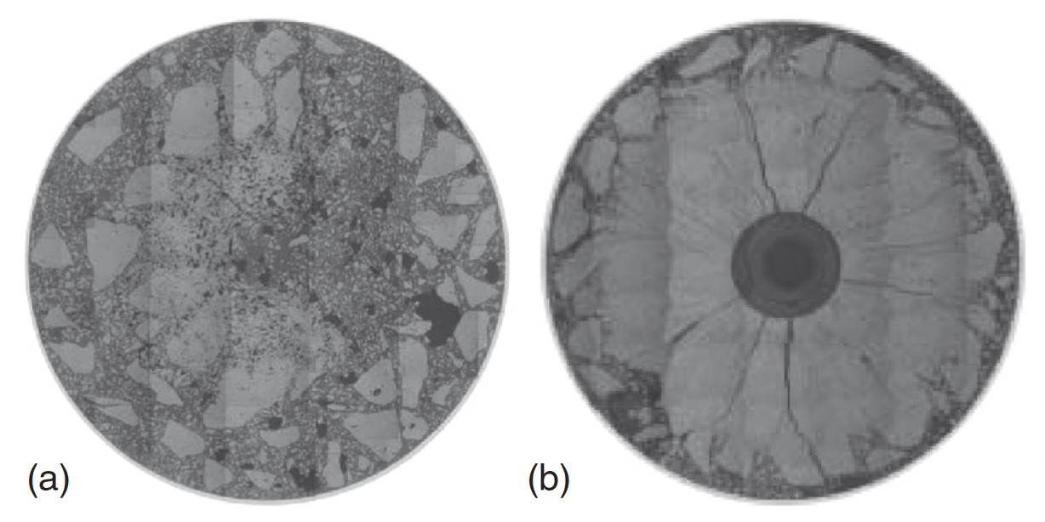
Vipac Irradiations
Japanese irradiations (FUJI Project), with MOX fuel 20% Pu
Vipac fuel after initial sintering test irradiated up to 487 W/cm after 36h
Restructuring test with ramping up to 502 W/cm for 36h and holding at 502 W/cm for 96h

Slide 6
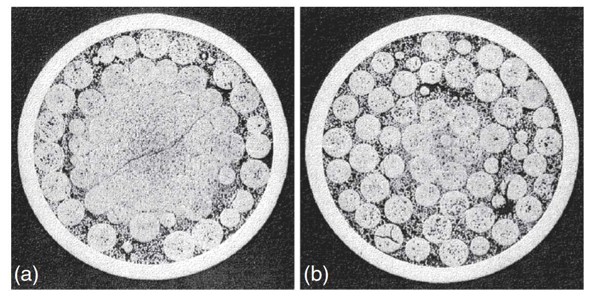
Sphere-Pac Irradiations
Dounreay fast reactor – UPu-C fuels
a) 62 kW/m, 7.3% FIMA, 458C
b) 49 kW/m, 5.7% FIMA, 320C

Slide 7
Overview
Particle fuels are a realistic option for fast reactor systems
Fast reactors allow for efficient burning of actinides
Nominal fast reactor fuel pins are designed for fission gas release, and thus the larger gas release, compared to UO2, is not detrimental
Other fuel bases, other than oxides, can easily be deployed
FCMI is greatly reduced due to the inherent space allowing for swelling of the particles
LWR application is limited

Slide 8
waste glasses

Slide 9
Waste Forms
Fission products (FPs) and minor actinides (MAs) produced during fuel irradiation in the reactor only represent about 5% of the weight of used nuclear fuel, but about 98% of its radioactivity
When fuel is reprocessed, the FPs and MAs end up in concentrated solutions (High Level Waste – HLW) temporarily stored in tanks
Long term (>100 year) storage requires a different path, with initial targets on glass or glass-ceramics to immobilize FPs
The first attempts at the CEA in 1957 targeted crystals of mica-phlogopite: M2Mg6(AlSi3)2O20F4
Twenty years later, borosilicate glass had appeared as the standard choice for the HLW matrix

Slide 10
Glasses
Some liquid phase materials have a high viscosity near the melting point, and such materials tend to crystallize slowly
If a cooling rate is faster than the crystallization rate, the material will rigidify into a “vitreous state”, in which no periodic crystal structure is present
Glass has an absence of order in the distribution of elementary structural units at scales larger than 10–30 Å
Glass is in a metastable state, but is not unstable because the energy barrier to bring it to its more stable crystallized state is generally significant due to the high viscosity
Glass is a non porous, impermeable, isotropic, non cleavable, elastic, solid with a fragile rupture behavior
Glass is a material which transitions continuously and reversibly from liquid to solid state with temperature

Slide 11
Waste Glasses
Vitrification consists of making a new material where the waste components are contained at the atomic scale within the matrix and can only be released by destruction of the network bonds
One major requirement is then that the selected matrix be able to incorporate all of the waste stream components in its structure
By using the flexibility brought about by the disordered and relatively loose structure of a glass, it is possible to design glass compositions able to integrate a very wide range of elements within their structure, and which are tolerant to compositional variations in the waste stream

Slide 12
Behavior of Waste Glasses
The main phenomena that could alter glass containment properties over the long term are heat (for HLW only), radiations damage and alteration by water
Heat can potentially induce the glass to reach a point beyond the glass transition temperature
However, in nuclear glasses the diffusion is sufficiently slow (high viscosity) to make crystallization incredibly difficult
In the R7T7 glass, a period of several millions of years are required for the three main phases to be completely crystallized at any temperature below 600C

Slide 13
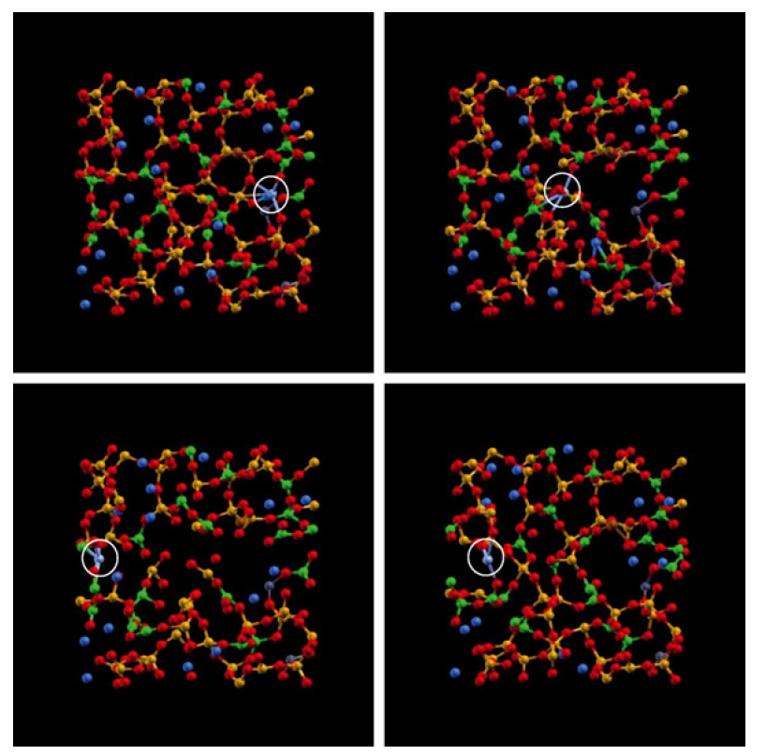
Radiation Damage
Alpha decay is the main cause of radiation damage, where a radioactive nuclide emits an alpha particle (He atom) and a recoil nucleus, generating damage cascades
Due to the effect of alpha decay the glass density decreases slightly, and its mechanical properties improve, especially fracture toughness
MD simulations have been performed that show the capacity of glasses to restore its structure following a cascade event

Slide 14
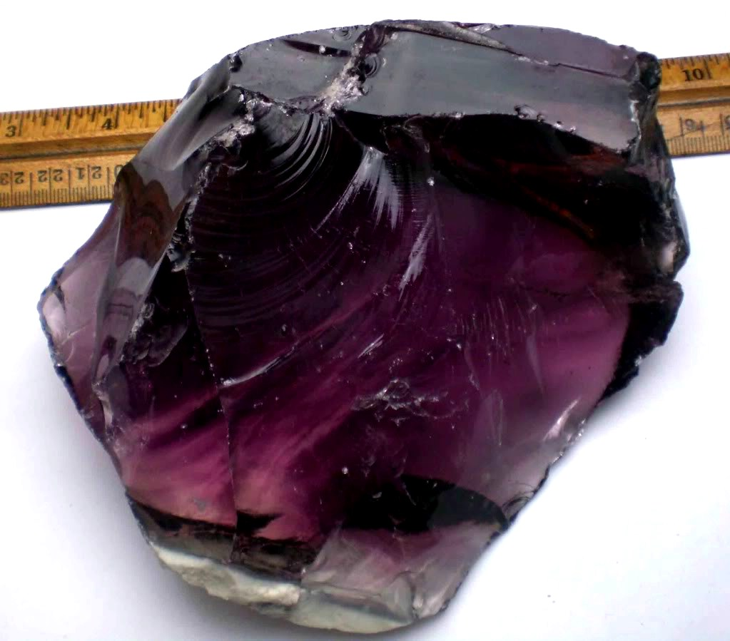
Waste Glass Summary
Vitrification is the world reference solution to the containment of HLW
Glasses can easily incorporate all known fission product species
Glasses will not undergo crystallization due to decay heat
Glasses self-heal irradiation damage
Glasses are reasonably resistant to long-term exposure to sea water

Slide 15
Questions?

